Slide 1




Slide 2
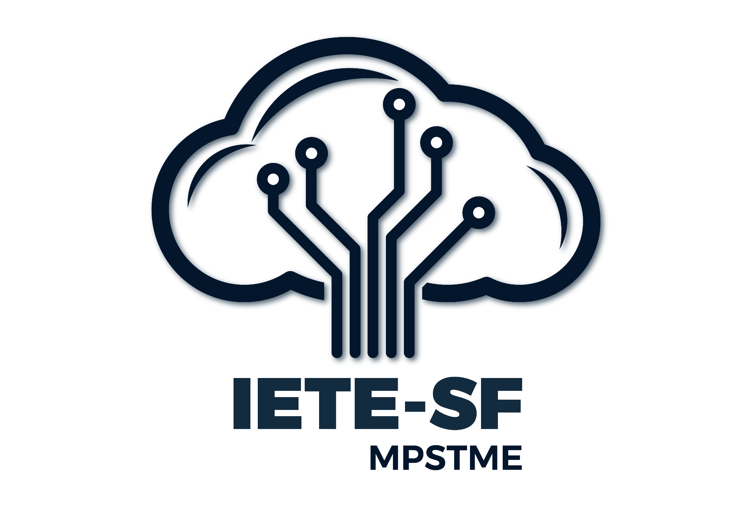
Fintech in Wealth Management
Harsh Gulwani Pratham Parakh Manav Puria
No Clue Coders

Slide 3
Road Map
Introduction
Problem Analysis
Detailed solution
Market/Users
Technology Stack
Demo
Advantage
Challenges & Learnings
Future scope
Conclusion

Slide 4
Introduce your domain briefly and explain your understanding with respect to the domain.
Introduction
The domain of Fintech in Wealth Management involves the application of cutting-edge financial technology to transform traditional wealth management practices. This domain focuses on integrating digital tools and advanced technologies to enhance the efficiency, accessibility, and personalization of financial services. The goal is to provide a seamless experience for clients, ranging from high-net-worth individuals to new investors.

Slide 5
Problem Analysis
What problem are you solving?
The primary challenge is developing a FinTech platform capable of delivering secure, real-time portfolio optimization for users with diverse investment profiles, including traditional assets and alternative investments like cryptocurrencies and Environmental, Social, and Governance (ESG) funds. This solution must address critical aspects such as risk management, tax optimization, and cross-border compliance.

Slide 6
Problem Analysis
Why is this problem important?
With the increasing complexity of investment portfolios and the growing inclusion of alternative assets, investors demand platforms that can seamlessly integrate various asset classes while ensuring compliance with regulatory standards. The ability to optimize portfolios in real-time, considering individual risk appetites and tax implications, is essential for maximizing returns and ensuring investor confidence.

Slide 7
Problem Analysis
Any supporting data/statistics
The global Fintech market is expected to reach approximately $324 billion by 2028
Industry growing at a CAGR of about 25.18% over the forecast period
There is huge demand for Real-Time Data Analytics
Wealth management firms are increasingly leveraging real-time data analytics to enhance client services and facilitate client in informed decision making.

Slide 8
Problem Analysis
Any supporting data/statistics
The Global Portfolio Management Software Market was valued at $3.2 billion in 2022 and is projected to reach $11.8 billion by 2032, growing at a CAGR of 14.2%

Slide 9
Detailed solution
Explain the possible solution/s in detail.
How will you approach the solution?
Real-time Portfolio Optimisation
Risk Management
Tax Optimisation
Integration of diverse asset/investment categories

Slide 10
Market/Users
Who will benefit from your solution?
User personas or target audience
Aspiring Investors Looking to Enter the Market
Comprehensive Solutions for Investors of All Ages
Experienced Investors Seeking Advanced Analytics
Global Investors Navigating Diverse Asset Classes
Notes:
Aspiring Investors Looking to Enter the Market
Our platform empowers newcomers by providing accessible tools, educational resources, and personalized guidance to help them confidently start their investment journey and generate profits.
Comprehensive Solutions for Investors of All Ages
A one-stop platform for investors of all age groups, offering features to manage diverse investment portfolios, track performance, and gain insights into their financial journey. It also provides tailored recommendations to enhance returns.
Experienced Investors Seeking Advanced Analytics
For seasoned investors, we offer cutting-edge analytics, risk assessment tools, and strategy optimization to refine investment decisions and maximize portfolio performance.
Global Investors Navigating Diverse Asset Classes
Our platform supports global investors by simplifying cross-border compliance, enabling seamless management of traditional assets, cryptocurrencies, and ESG investments—all under one roof

Slide 11
Market/Users
Potential impact
Informed Decision making
Better Data Visualisation
Identify trends in investments
Informed Clients
Increased Financial Literacy
Tax Optimisation
Increased Client Trust
Notes:
By offering a clear and detailed overview of investments, clients gain better control over their portfolios, allowing them to make informed decisions.
Graphs and visualizations can make complex data easier to understand. Clients can quickly grasp trends in their investments over time and the relative success of different sectors.
Visual tools could help users identify patterns or areas for improvement in their investment strategy, leading to more informed decision-making.
Providing up-to-date market news allows clients to stay informed about external factors that could affect their investments, enabling them to act proactively
Providing educational resources can help your clients make better decisions by improving their financial literacy, leading to smarter investment choices.
Personalized tax advice can lead to better financial outcomes for your clients by optimizing their investment strategies to minimize tax liabilities.
Offering expert advice on tax-saving strategies can position your platform as a trusted financial advisor, increasing user loyalty and satisfaction.

Slide 12
Technology Stack
Tools, languages, and frameworks used
HTML
CSS
JavaScript
VScode

Slide 13
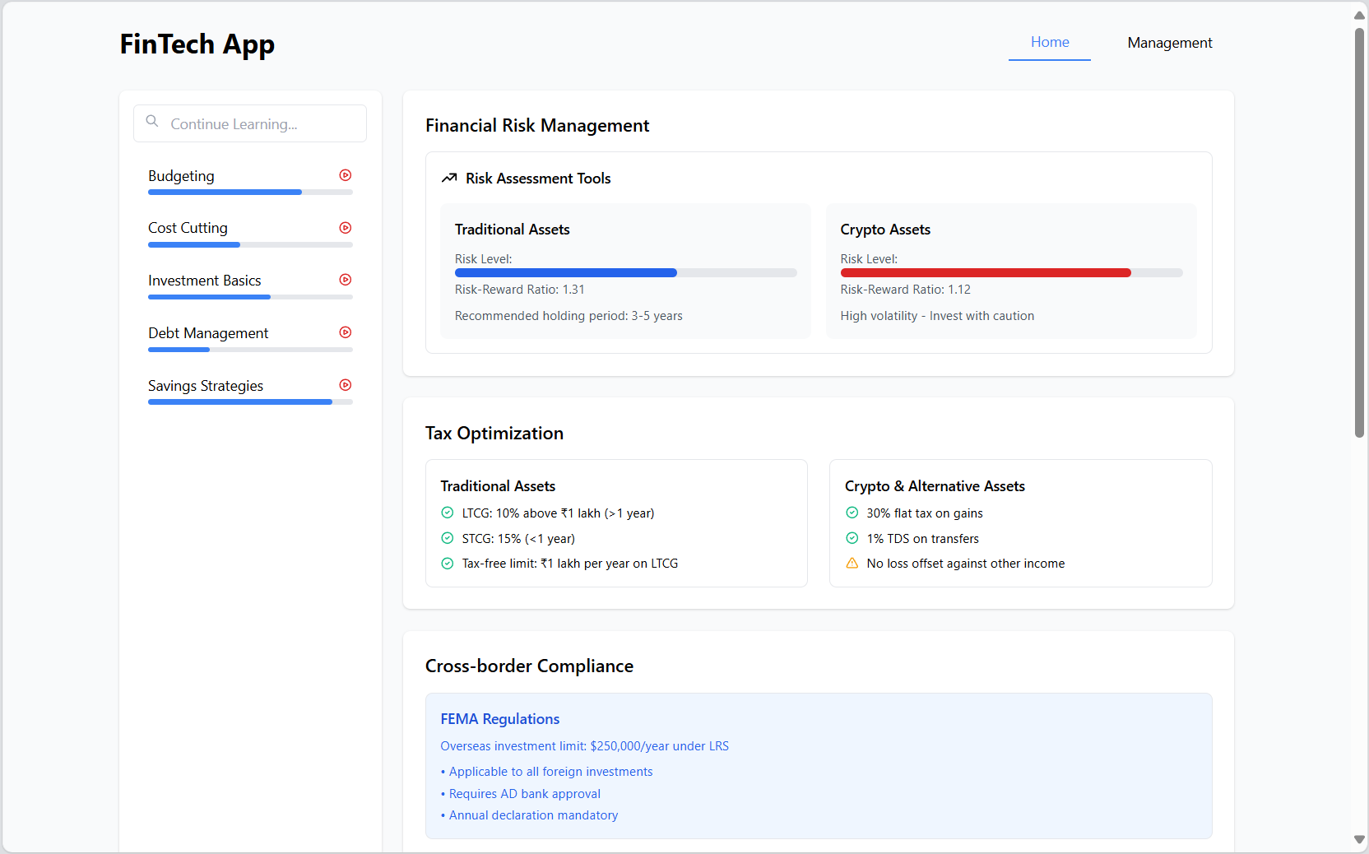
Demo
Live demo or screenshots of your working prototype
Key features walkthrough

Slide 14
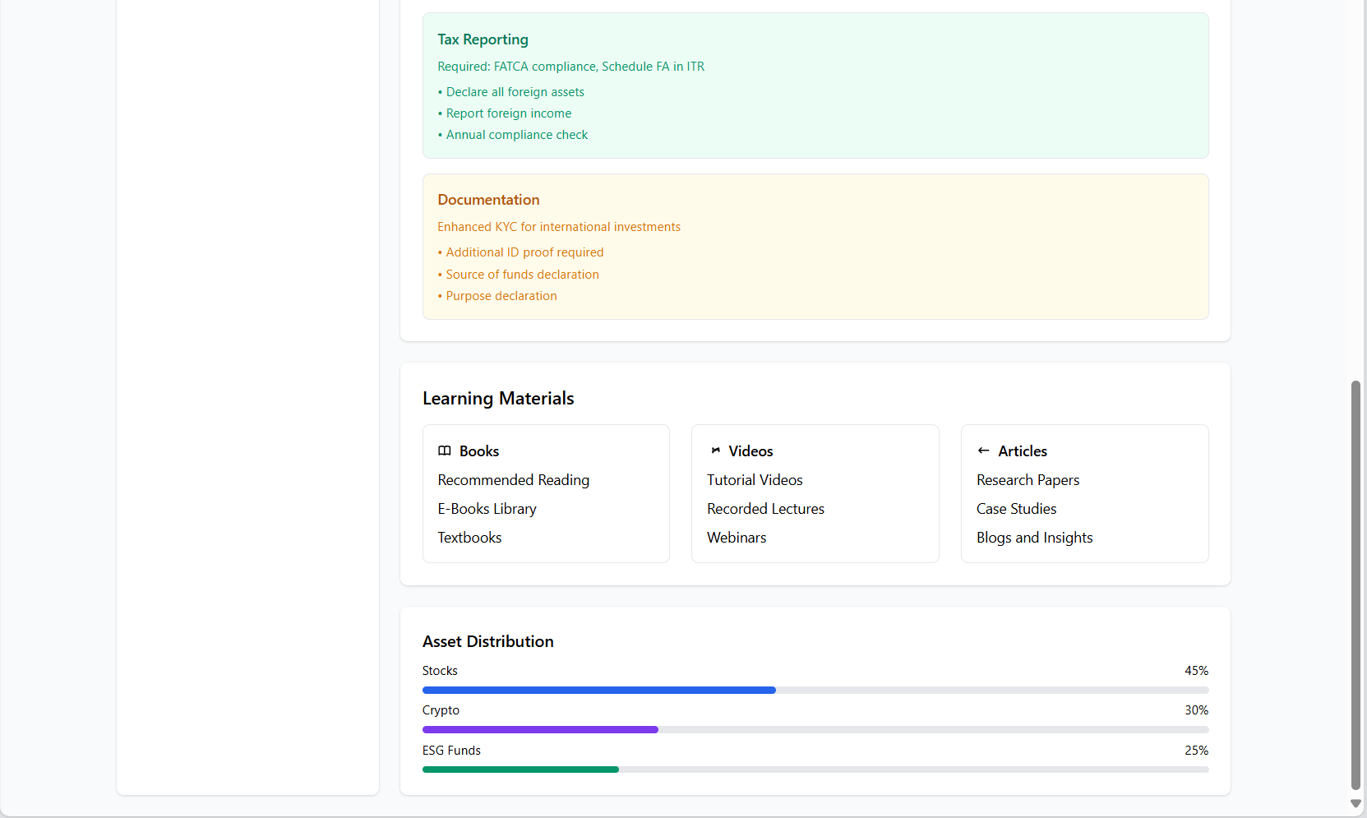
Demo
Live demo or screenshots of your working prototype
Key features walkthrough

Slide 15
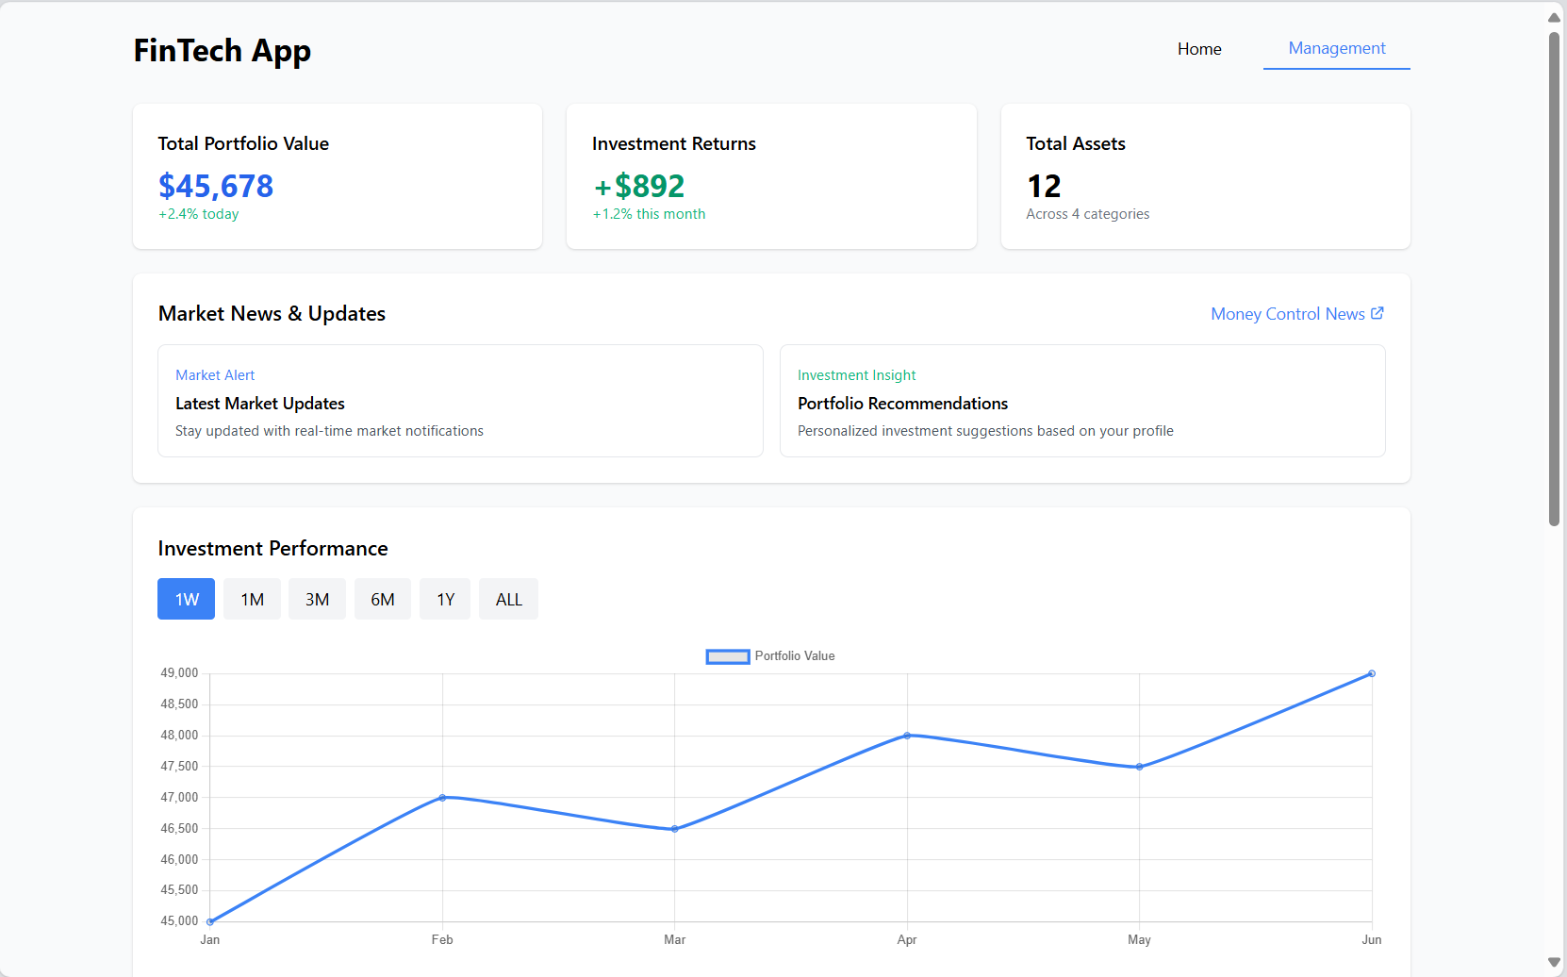
Demo
Live demo or screenshots of your working prototype
Key features walkthrough

Slide 16
Advanatges
How is your solution better/different?
Unique selling points
Comprehensive and Inclusive Investment Dashboard for quick analysis
Self adjusting recommendations tailored to the client’s requirements and flexibility
Tax Optimization: We legally help the client to save on taxes while simultaneously assisting them on how to increase the profitability of their investments.

Slide 17
Challenges & Learning
Technical or team-related challenges faced
How you overcame them
Difficulty in figuring out the functioning of JavaScript
Took time to coordinate and distribute work as each one of us had almost similar technical knowledge
Had to learn CSS to beautify the site content
Couldn’t figure out how to connect backend with frontend

Slide 18
Future Potential
Areas for further improvement.
Making a more user-interactive interface
Connecting the site with actual backend data
Integrating GenAI to incorporate and display reports from trusted sources like JP Morgan, Motilal Oswal, etc.
For crypto and stocks, we can ask user his stop loss limit

Slide 19
Future Potential
Growth after improvement.
Increased reach with target audience by improving user interface
Better risk management techniques by leveraging AI

Slide 20
Conclusion
Creating a secure and real-time FinTech platform that seamlessly manages diverse investment portfolios—spanning traditional assets, cryptocurrencies, and ESG funds—offers a transformative opportunity. By prioritizing risk management, tax efficiency, and compliance with international regulations, such a solution not only addresses pressing challenges in wealth management but also empowers investors to make confident, data-driven decisions.

Slide 21
References
Wealth Management Platform Market Size, Share | Growth, 2032
Fintech Market Growth Statistics - Blue Tree Digital
Wealth Management Software Market Size Report, 2030

